Slide 1
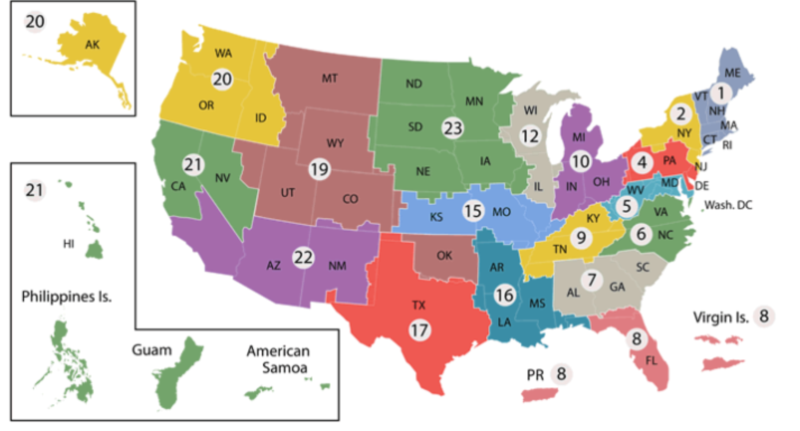
Network of Dedicated Enrollment Sites (NODES)
Anchorage
Puget Sound
Portland
Minneapolis
Ann Arbor
Boston
Madison
West Haven
Omaha
Hines
Bronx
Salt Lake City
Cleveland
Philadelphia
Aurora
Palo Alto
Greater Los Angeles
Long Beach
Atlanta
San Diego
Dallas
Houston

